Slide 1
Capstone Project: Eindhoven clusters
Difference between various regions and consequences for business

Slide 2
Introduction
Eindhoven is one of the fastest growing regions in Europe due to its status as the “Brainport”
The city attracts talent from across the globe to come live and work
This growth brings with it the possibility of increased economic output which is good for businesses in the city
However, if you were a business in the city, where would you expand to or want to establish yourself?
The aim of this project is to identify the areas in the city that are most identical using K-means clustering.

Slide 3
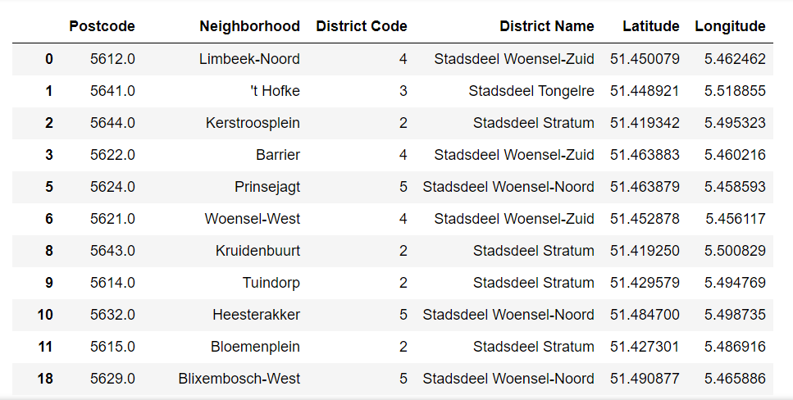
Data (1/2)
Two data sources are used:
Eindhoven local directory database
Foursquare API venue data
Overview of local directory data

Slide 4
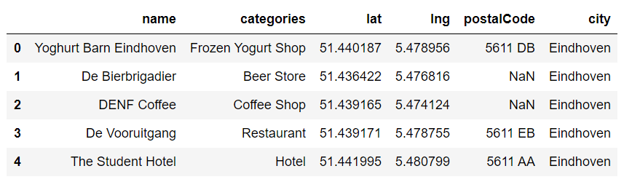
Data (2/2)
The Foursquare API data did not have a lot of venue data for all postal codes.
In total, only 10 postal codes are present in the venue data
This leaves us with a limited scope to conduct our research
Letter codes are removed from the postal code data to leave the postal region which will be used as the basis of analysis for this project.
Overview of local directory data

Slide 5
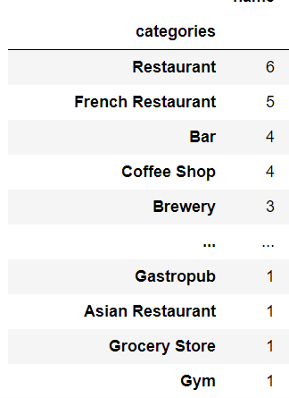
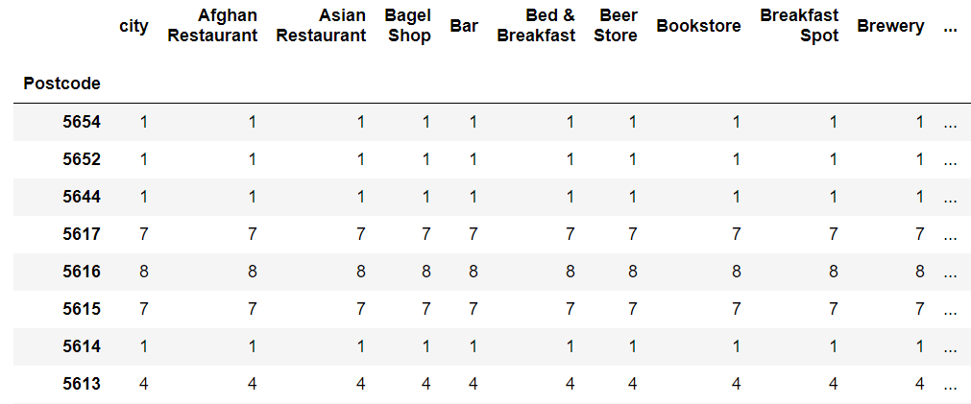
Exploring the data
Spread of venues over postal codes
Frequency of venue categories

Slide 6
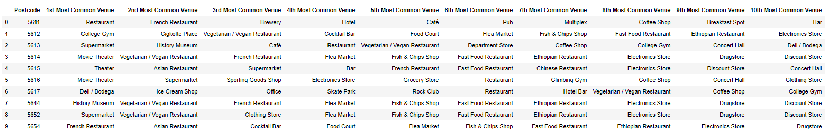
Region profiles
The most common venues for each postal code is found and categorized based on their frequency per postal code
This will be the information used to identify similar locations.
Postal codes with their most frequent venues

